Slide 1
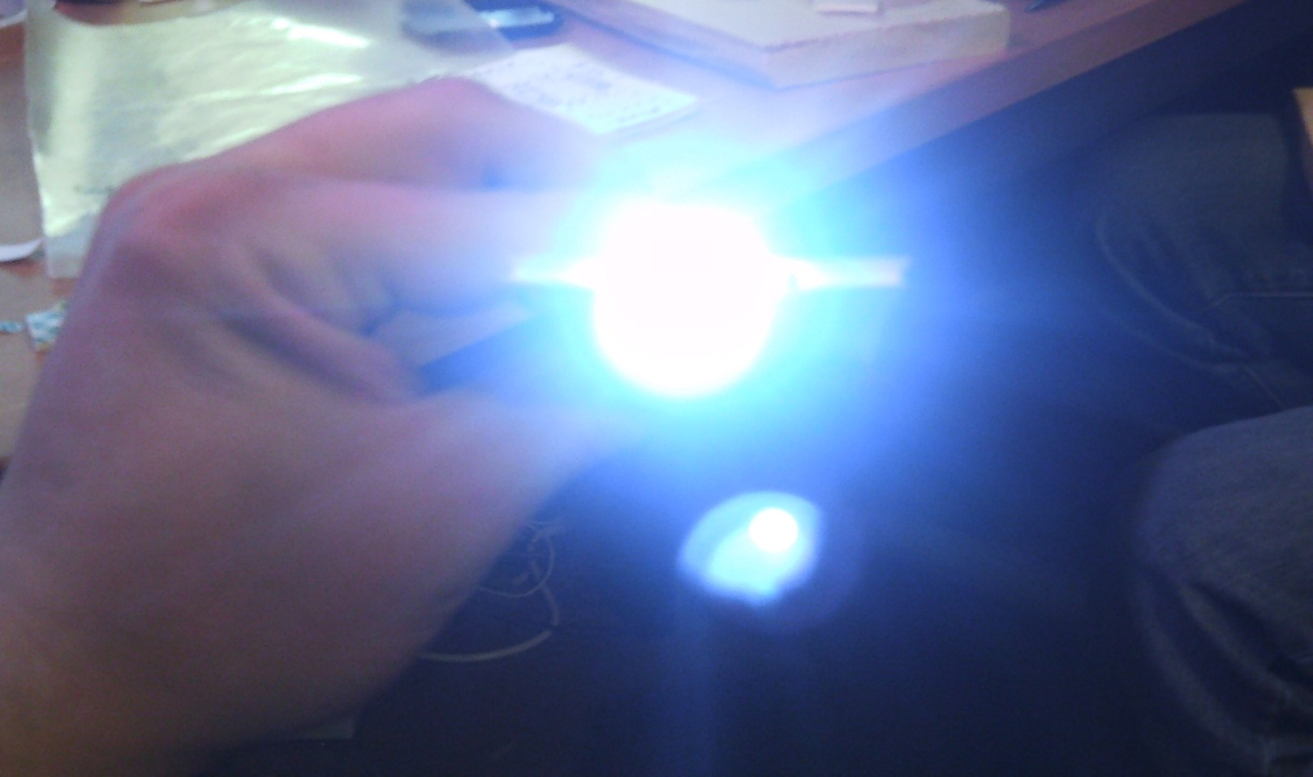
Business Card Flash light Assembly Station
By Mr. Petrone, Mr. Abbott, Mr. Serles, and Mr. Levine

Slide 2
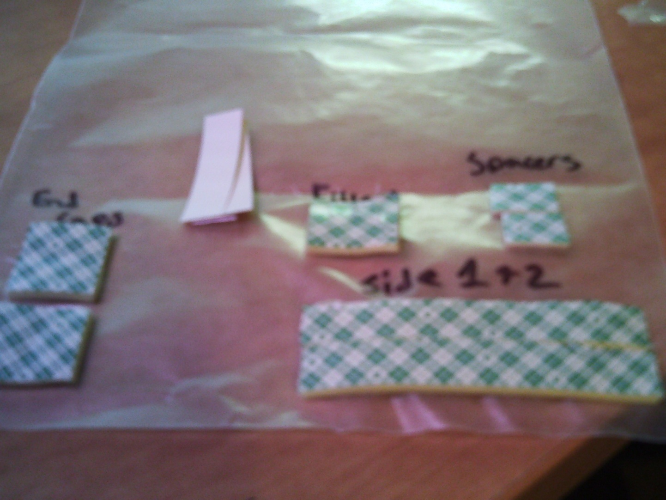
Step 1- make sure that your kit contains all necessary parts as shown. Plus an battery, LED Light, and a piece of electrical tape.

Slide 3
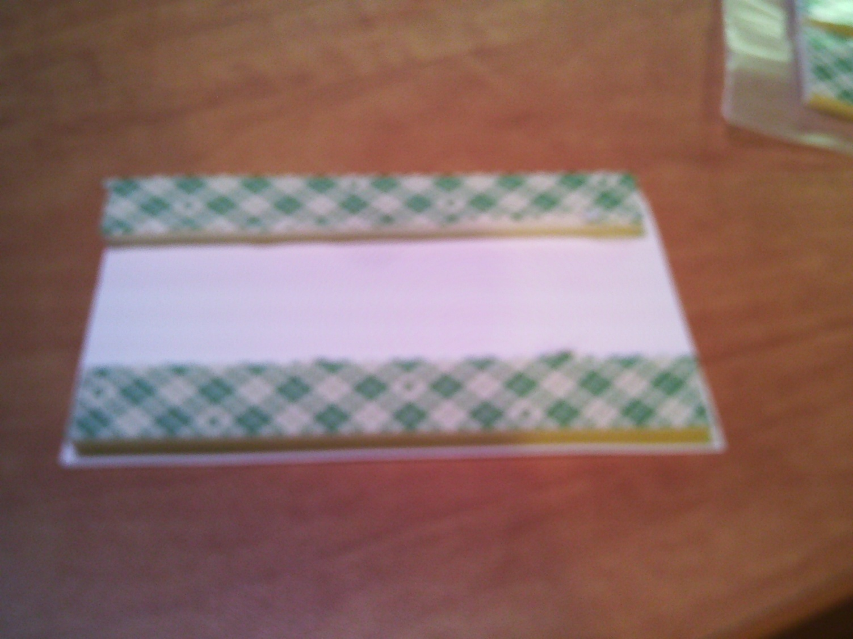
Step 2- Attach the long pieces of tape to the back of the card (labeled side 1 and 2).

Slide 4
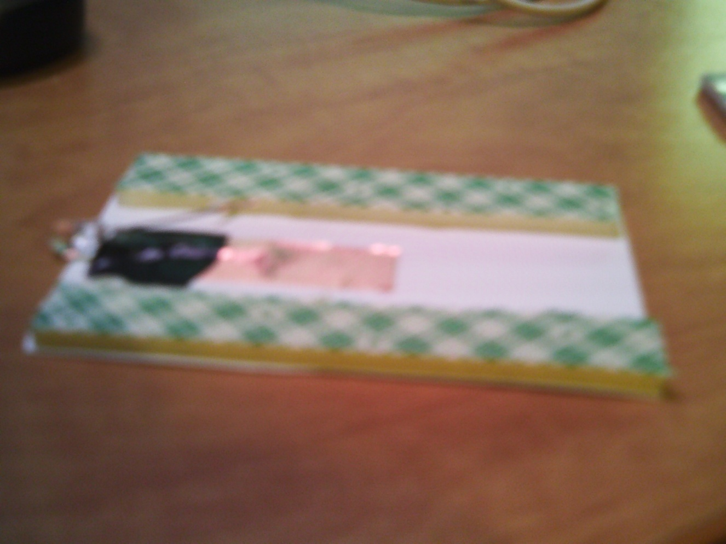
Step 3- Attach the long side of the LED to the card stock with the copper tape, then apply the electrical tape as shown.

Slide 5
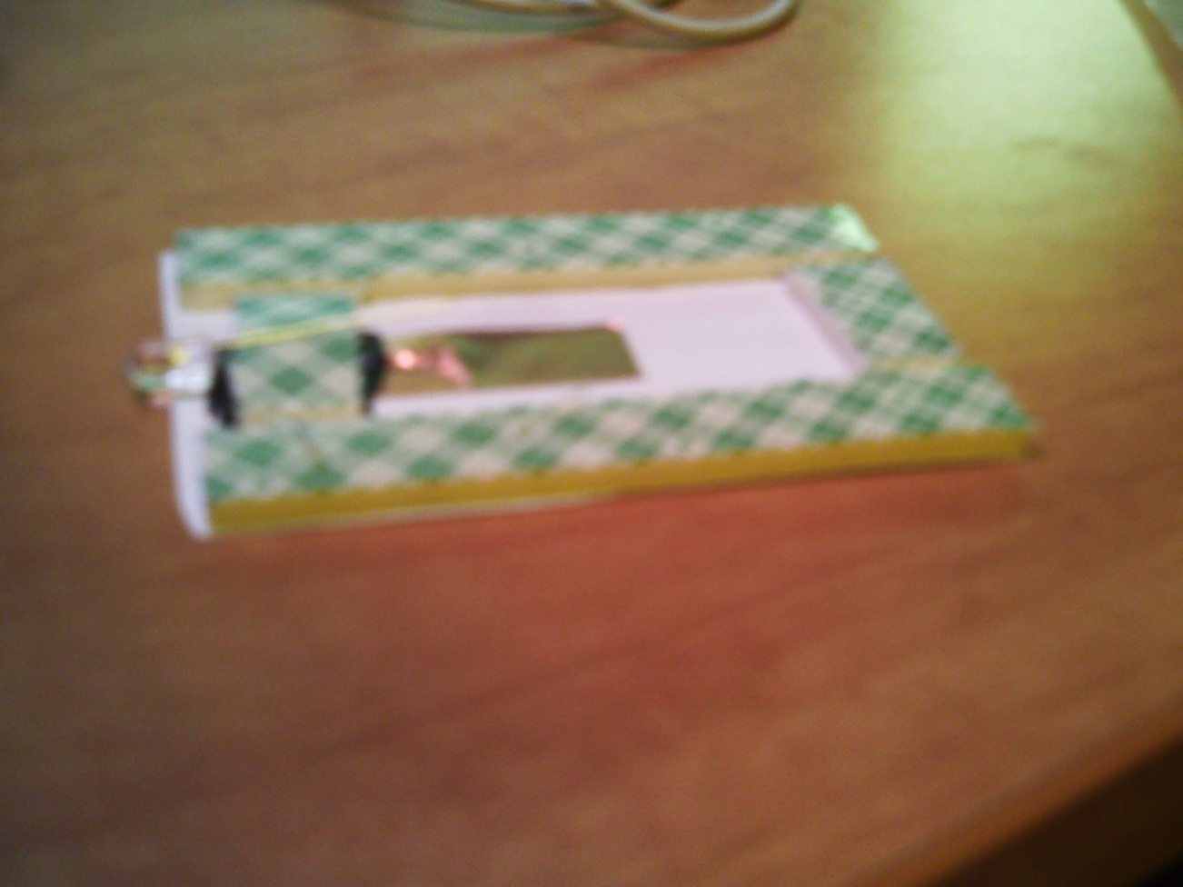
Step 4- Apply the pieces labeled End Caps, and attach them as shown. NOTE: be sure to leave the short end of the LED exposed.

Slide 6
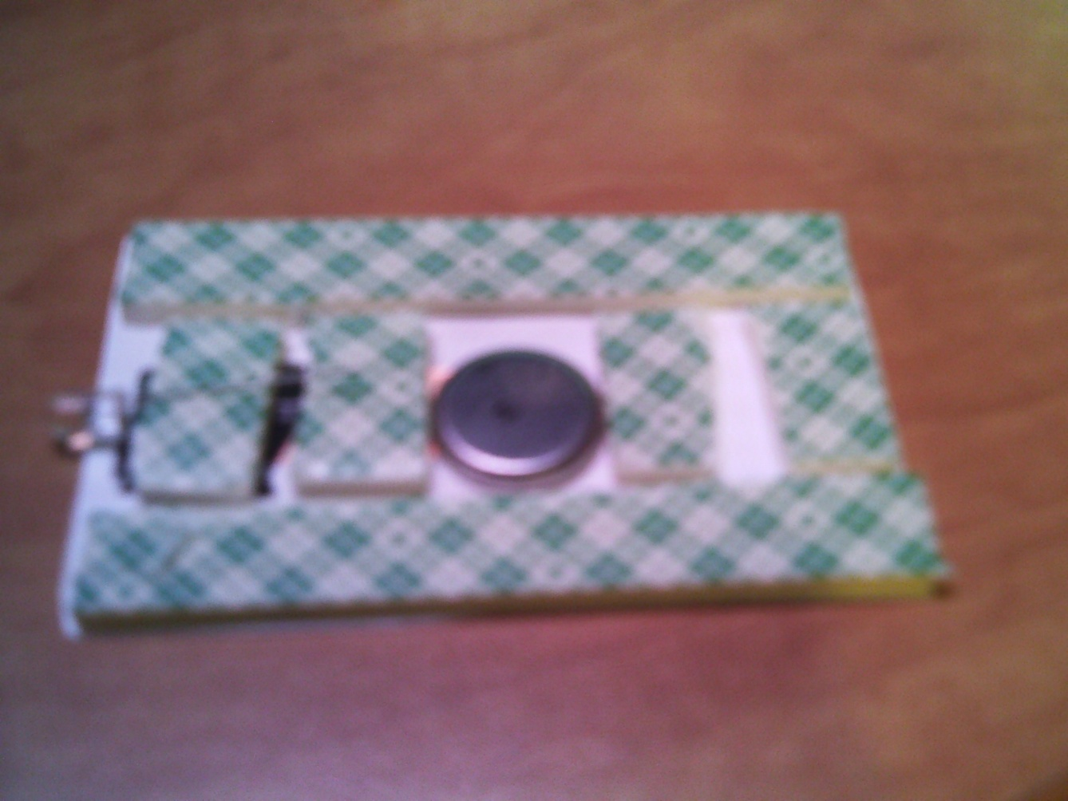
Step 5- Place the battery in the center of the card stock. Place the End Caps in such a way as to encase the battery.

Slide 7
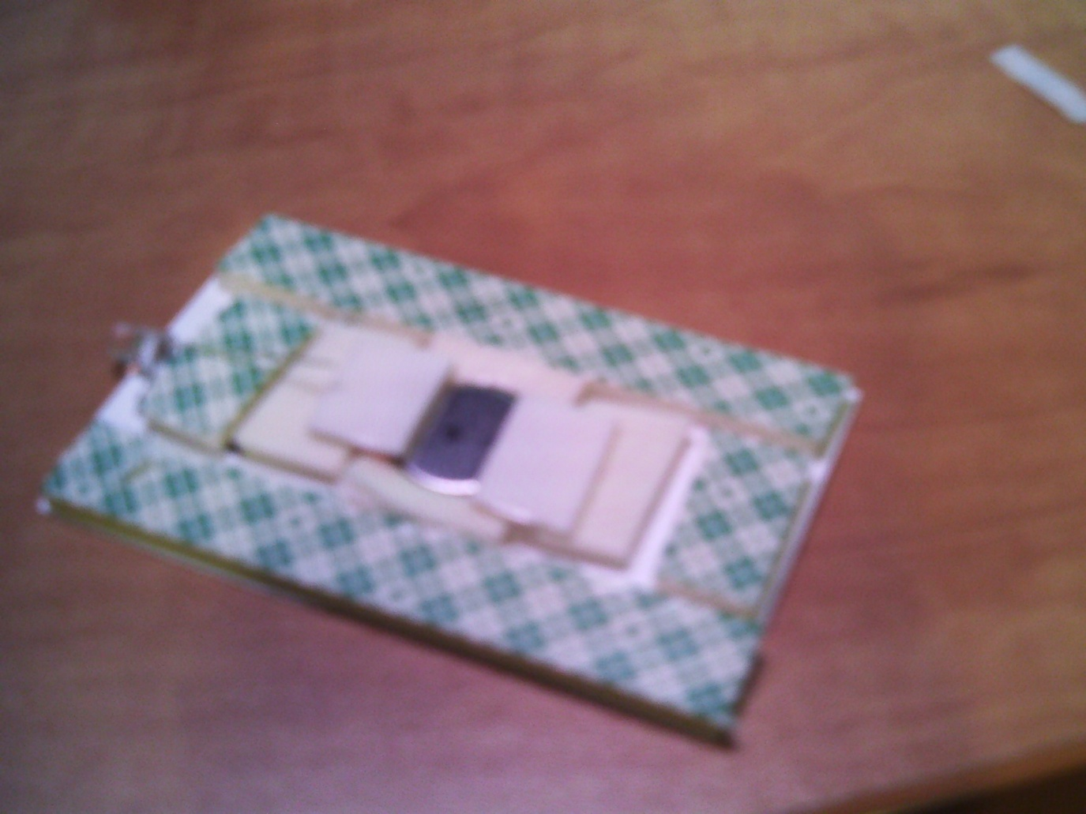
Step 6- Apply the Filler strips in order to secure the battery. Remove the backing from the End Cap and attach the spacers for the buttons.

Slide 8
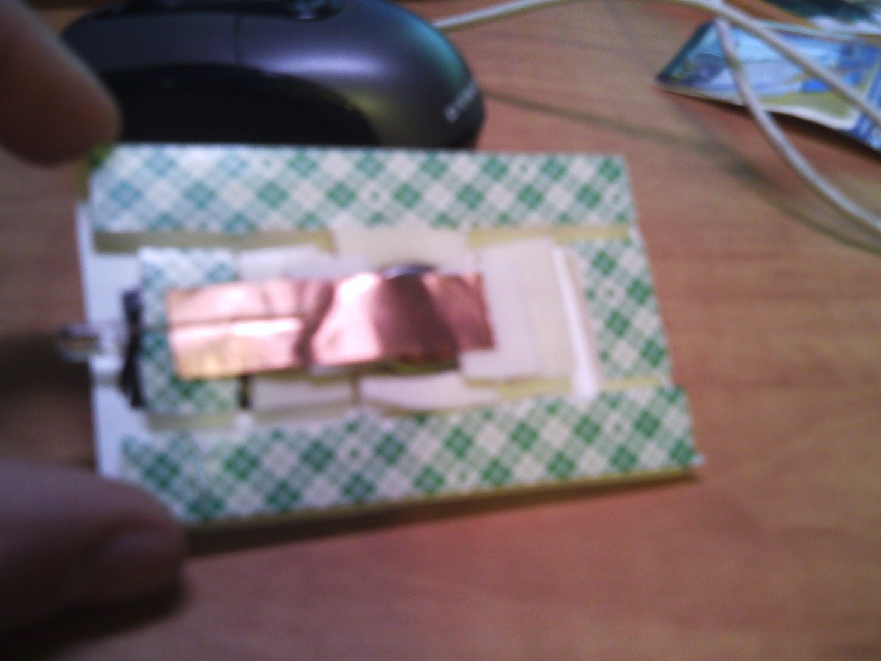
Step 7- attach the copper tape to the exposed lead of the LED.

Slide 9

STOP! We will now come around and make sure that all components are assembled properly.

Slide 10
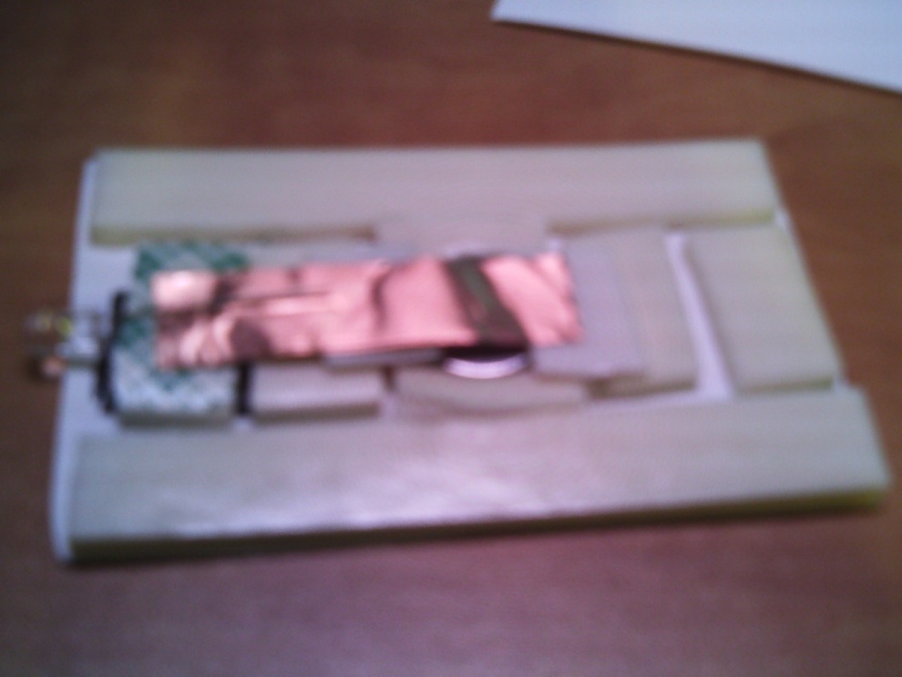
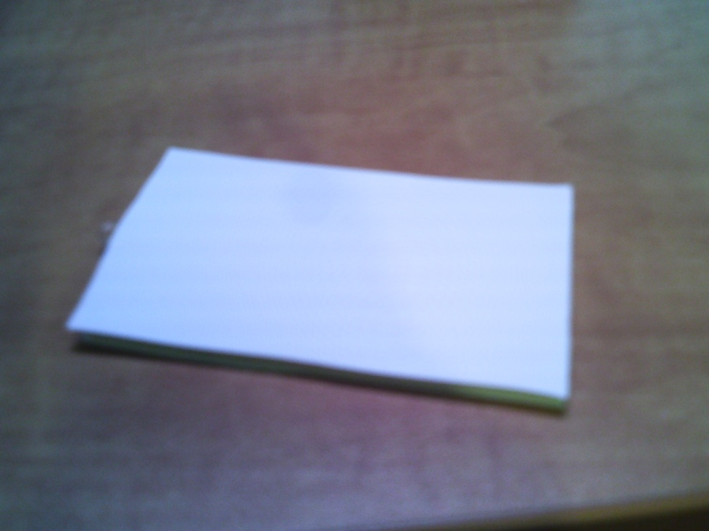
Step 8- Remove the backing from all tape. Carefully attach the other side of the card stock.

Slide 11
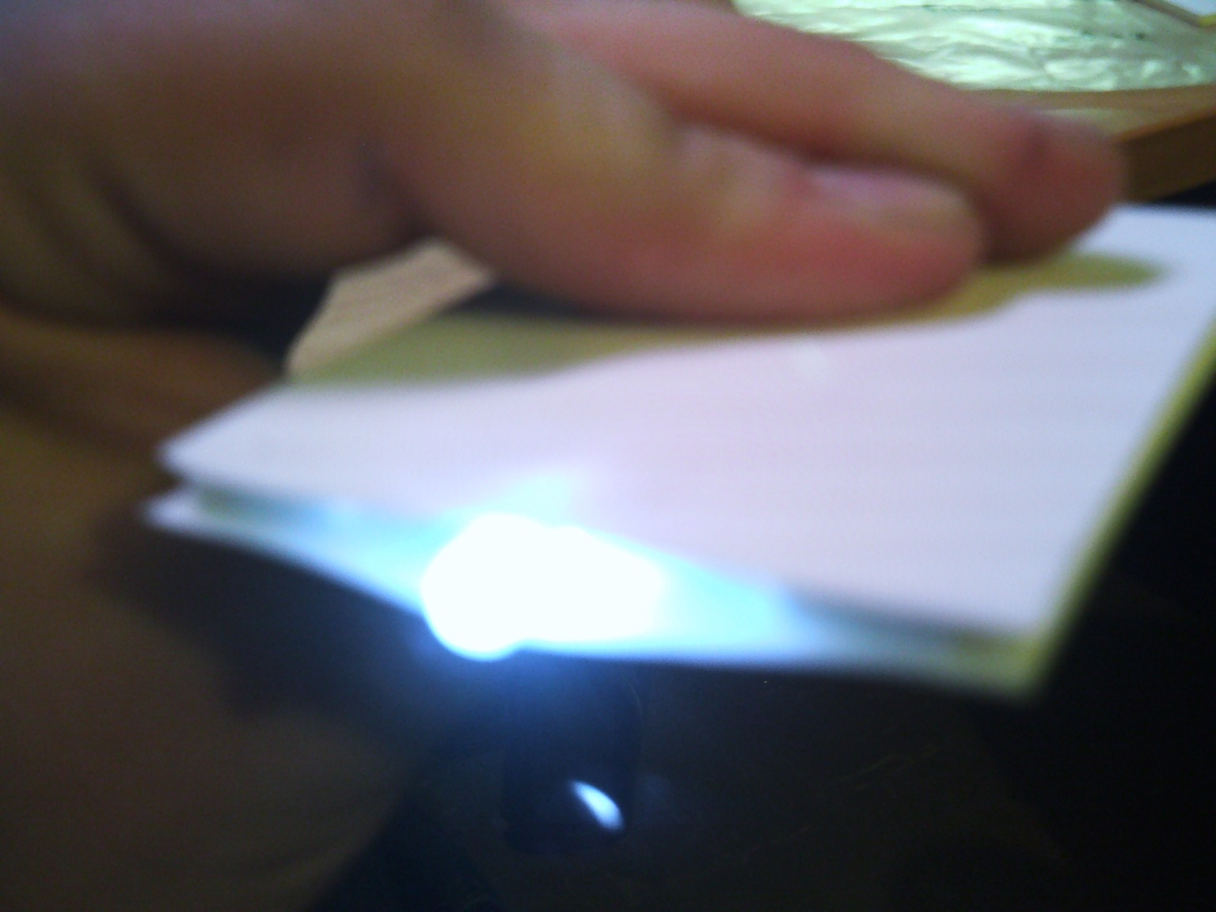
Enjoy the Flash Light Card!!!

