Slide 1
Eelgrass Replacement Project –
STEM at Southampton High School
Presenters:
Julia Best, Technology Education Teacher
Greg Metzger, Science Teacher
Eric Pflug, Math Teacher

Slide 2
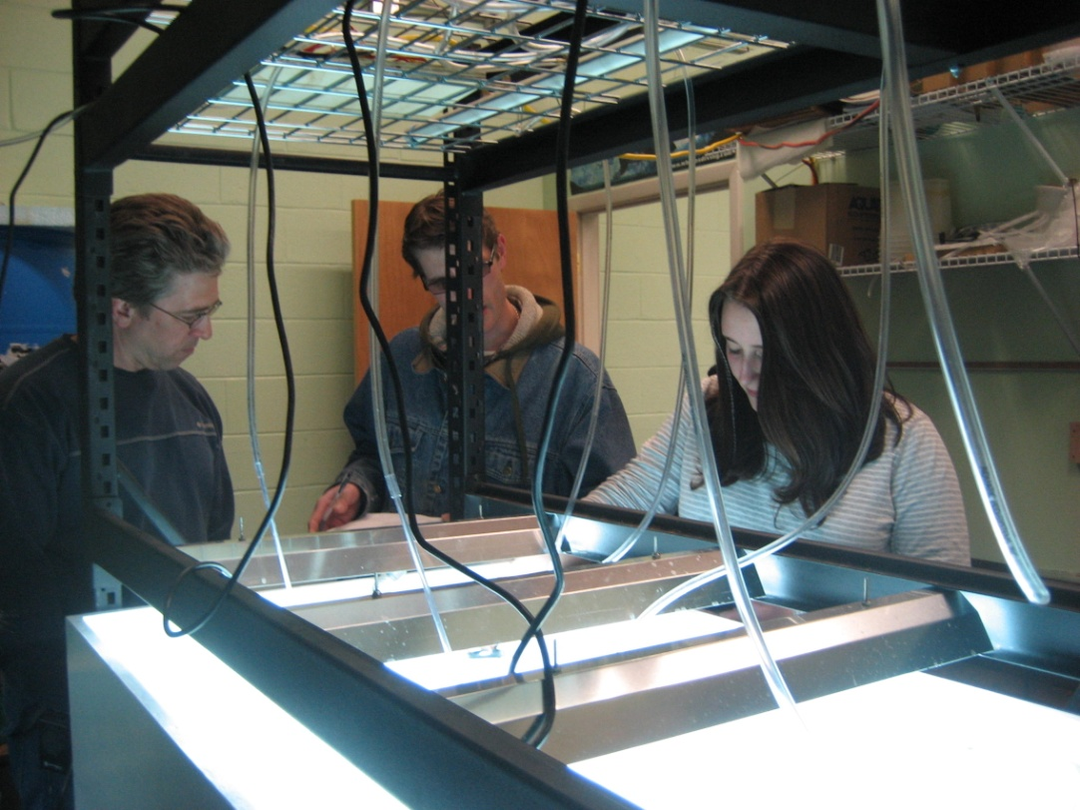
How it all began…
Science
Inspiration:
Toured Cornell Cooperative Extension’s Eelgrass Facility with science students
Met Chris Pickerell, Coastal Restoration Expert/Habitat Restoration Specialist
Saw hand production process of “tortillas” (mats for eelgrass replacement)
Brought the idea back to Technology Education Department to improve the mat making process

Slide 3
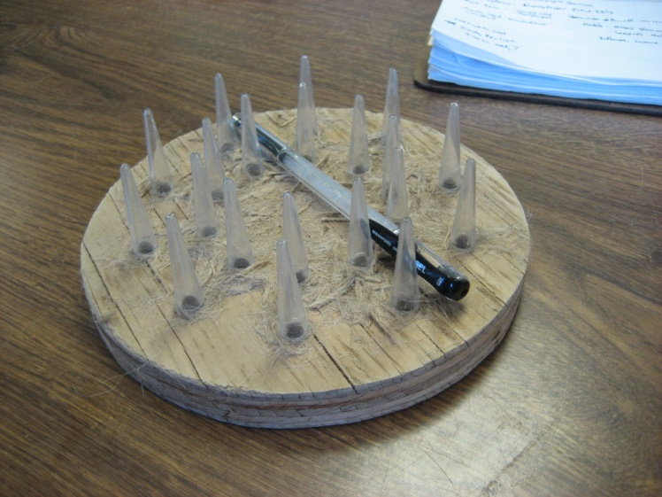
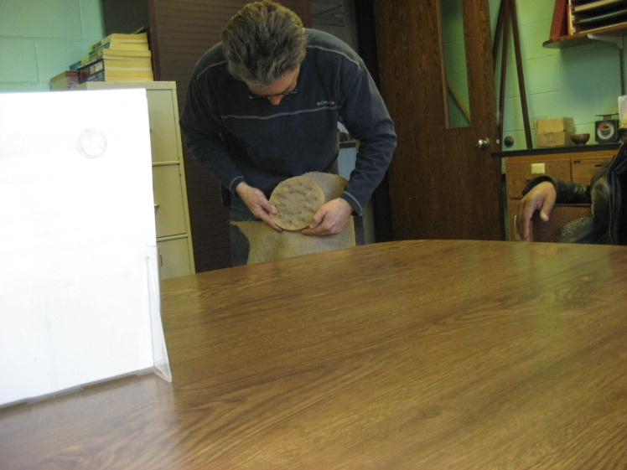
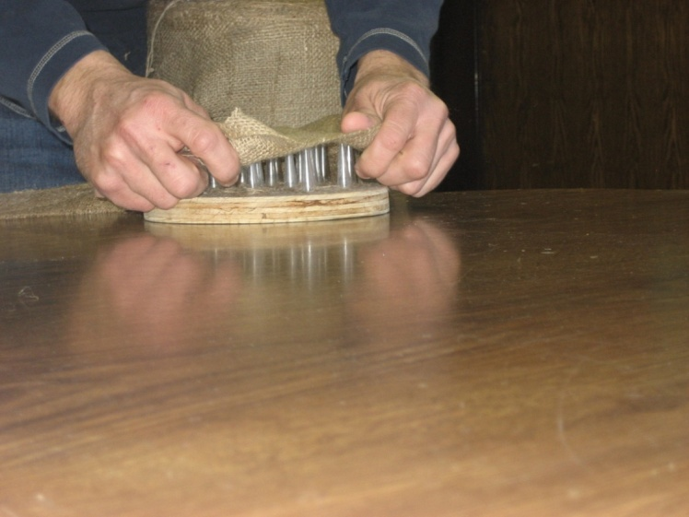
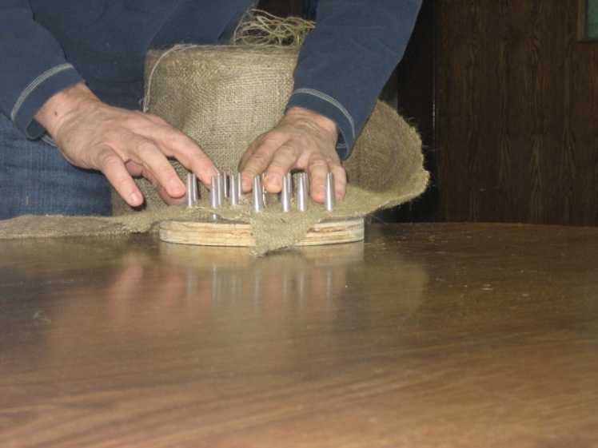
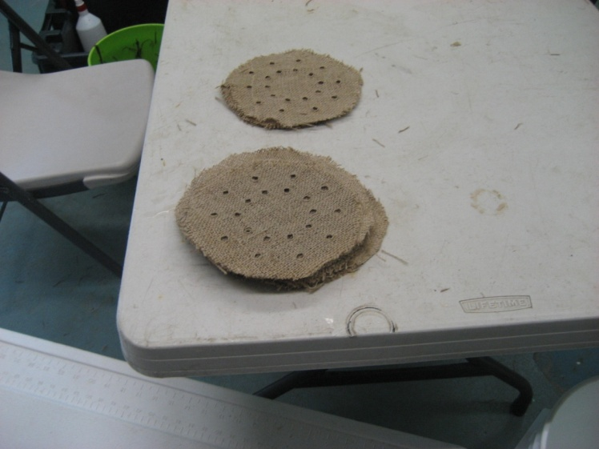
Hand Process for Mat Making
Original jig with pen for scale
Starting to position burlap on jig
Finished stack of hand formed & cut mats

Slide 4
Original Drawing from Chris Pickerell - Math
“Tortilla” maker
(we haven’t come up with a good name yet!)
36deg
Should be rounded (almost pointy)
3.7cm*
*Nothing special about this height
13cm
18cm
7.6cm
2.6cm
1cm
2.6cm
All of these dimensions are pretty critical on the form

Slide 5
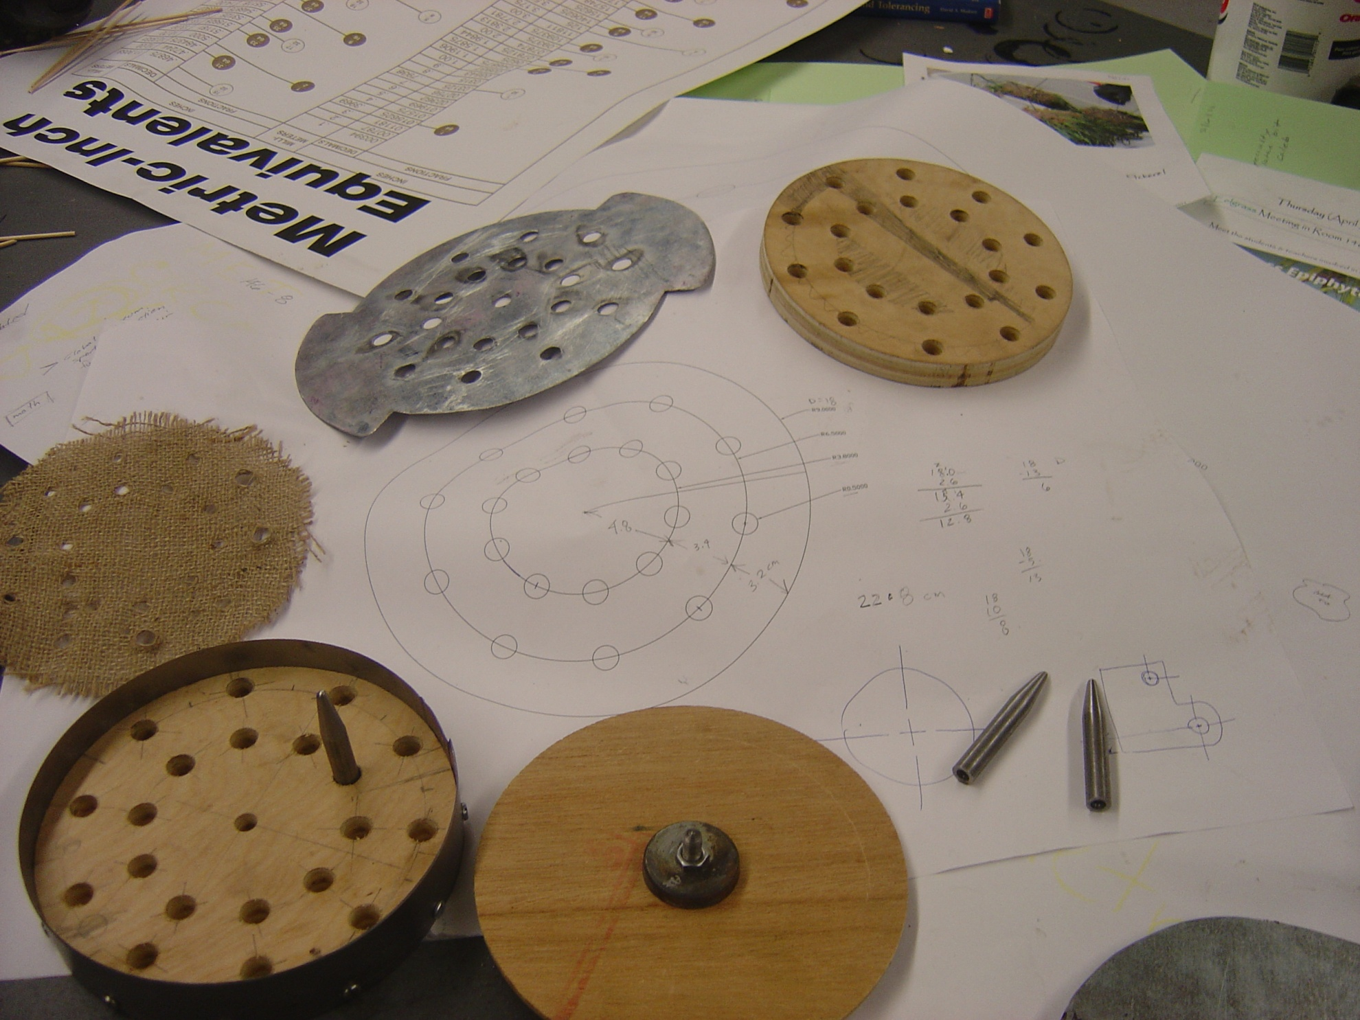
Design & Fabricate the Jig – Technology
The Challenge – Increase overall production speed!
Original idea sketches (brainstorming)
AutoCAD drawing & notes
Phase I: the first parts– spikes, ejector plate, drill press (not shown), cutting ring, positive/spike holder, negatives/mat flatteners
Metric-Inch conversion chart

Slide 6
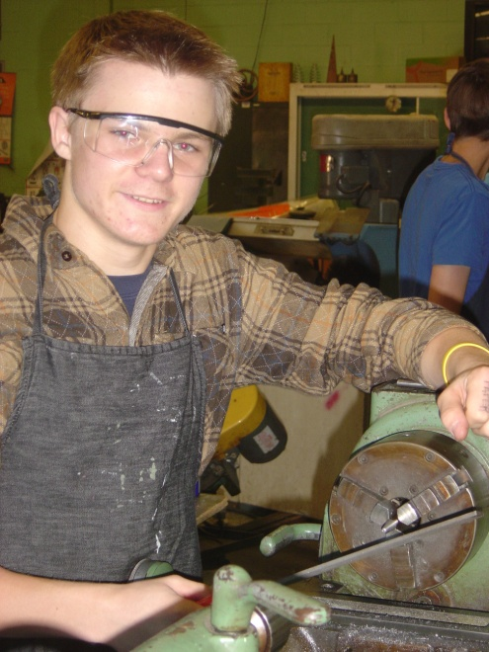
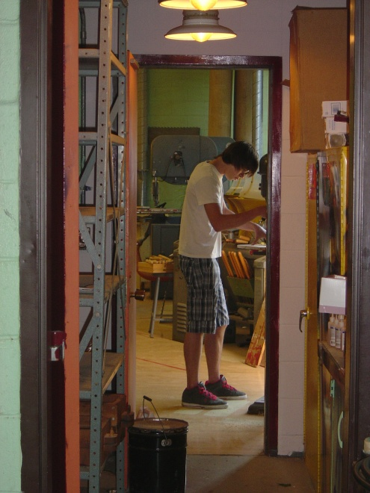
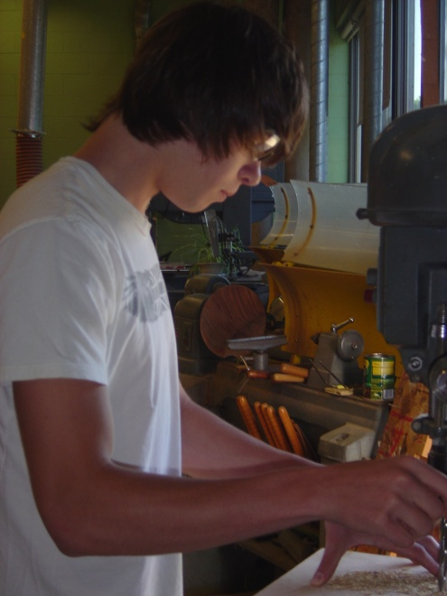
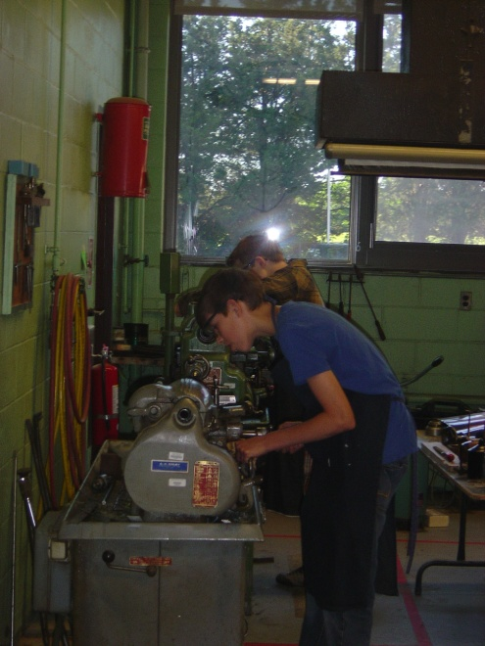
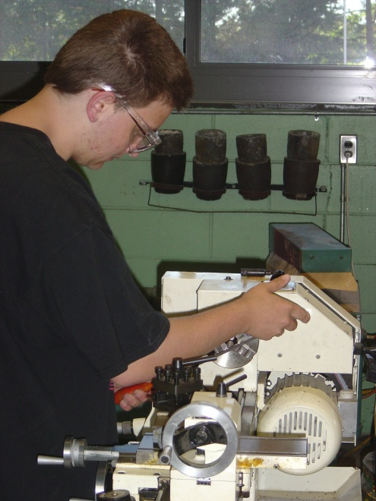
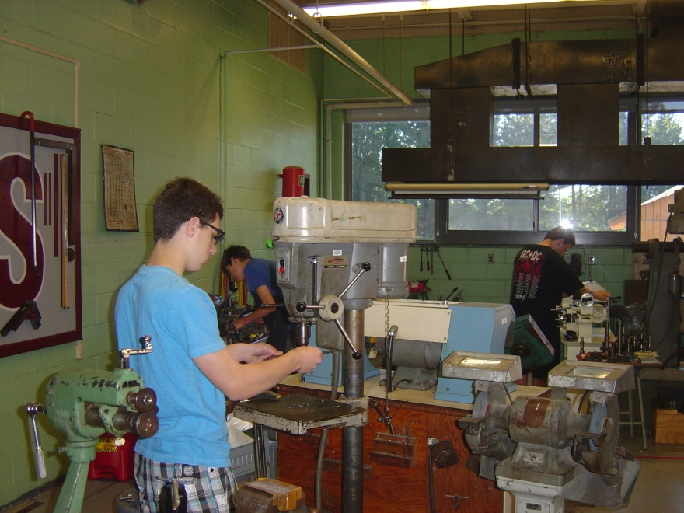
Traditional Fabrication Procedures
Wood Lab – Drill Press, Band Saw…
Metal Lab – Lathe work – facing, taper turning, polishing…

Slide 7
Transitioning to STEM
Our supportive Departments:
Technology Education (1.2 Teachers)
Science (10 Teachers)
Math (6.2 Teachers)
Our new principal is in favor of developing a true STEM program and supports our teacher driven projects, efforts & initiatives. For example, flexible program offerings such as “Hatchery Design & Set-Up” which will evolve into “Hatchery Management.”
Our district supports our work as it is in the process of major renovations, especially in the Sciences. For example, the construction of a new Marine Science Lab.

Slide 8
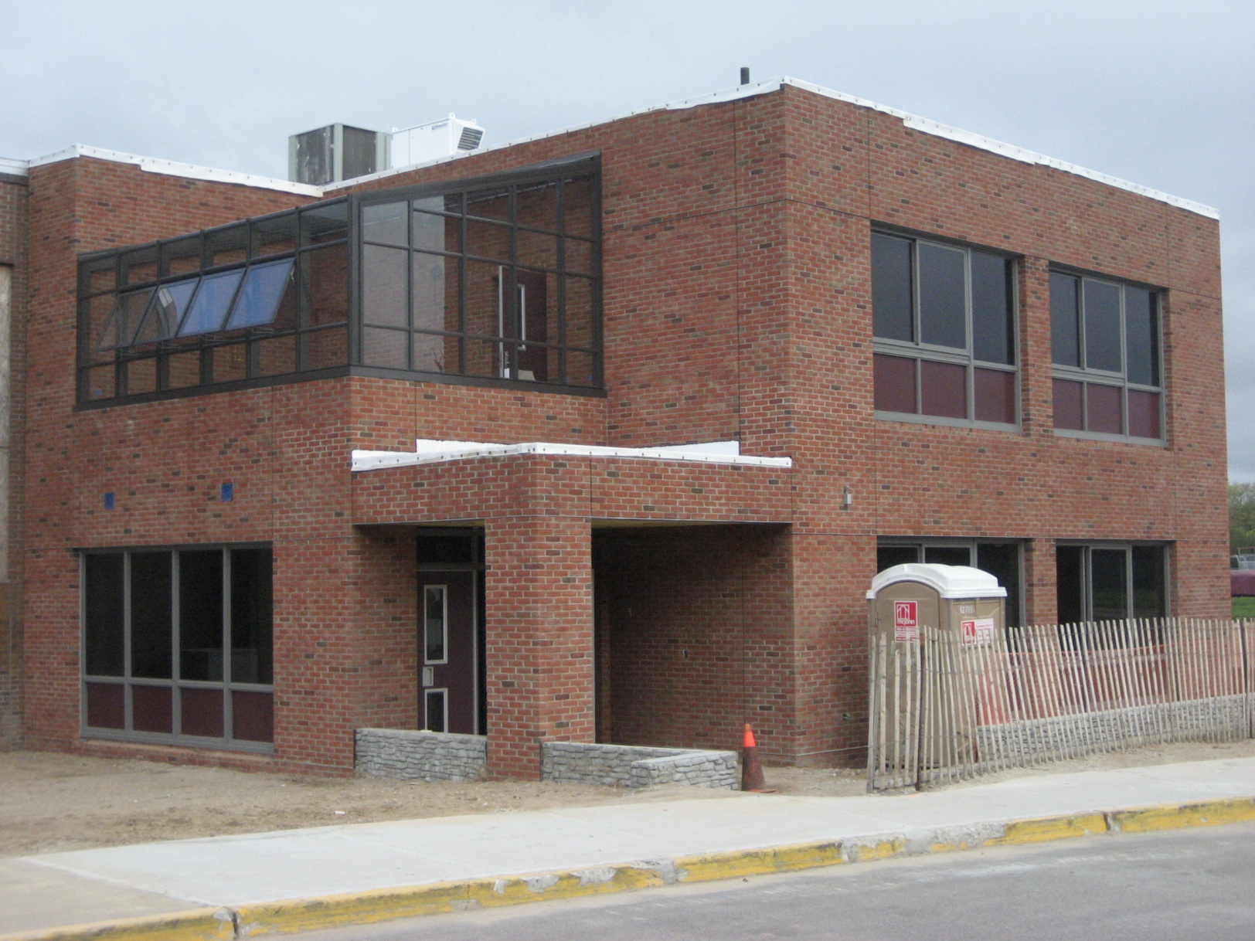
The New Marine Science Lab
Exterior View

Slide 9
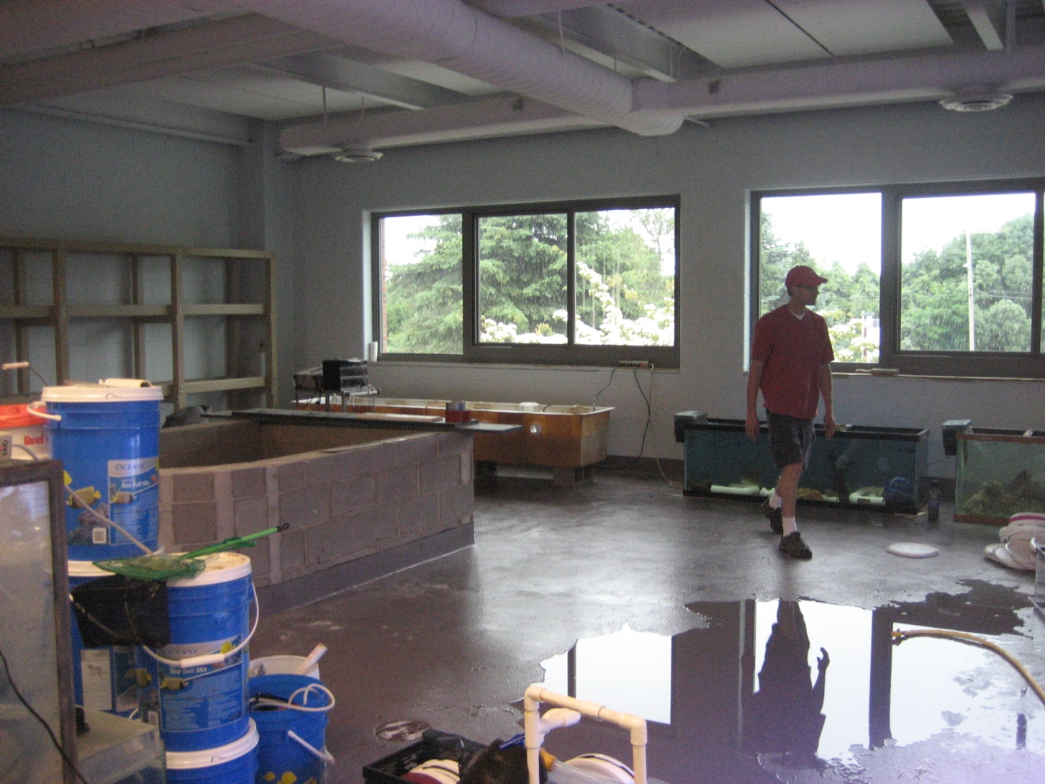
The New Marine Science Lab
Interior View – Under Construction

Slide 10
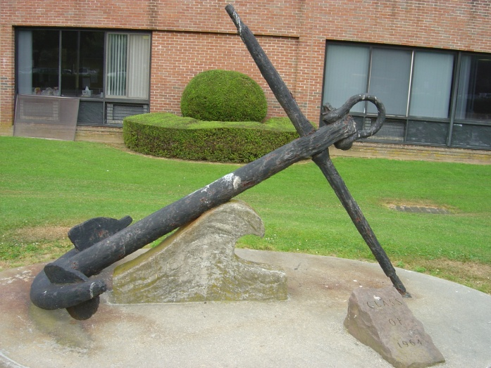
A Little Bit About Our School
Southampton High School (582 students)
141 Narrow Lane
Southampton, NY 11968 (East End of Long Island, the”South Fork”)
http://www.southamptonschools.org/HighSchool.cfm
Demographics Statement from the District Office:
“Southampton Union Free School District has a total enrollment of 1587
Pre-K through 12th grade students in a rural setting. Of those students ,
394 students receive free lunch and 111 receive reduced lunch which
translates into 33% of the K-12 population receiving free/reduced lunch.
The students in Southampton are diverse in many ways, including
ethnicity. 3% of the population is Asian, 5% African American, 26% Hispanic,
9% Native American, 0.1% Pacific Islander, and 57% Caucasian.”

Slide 11
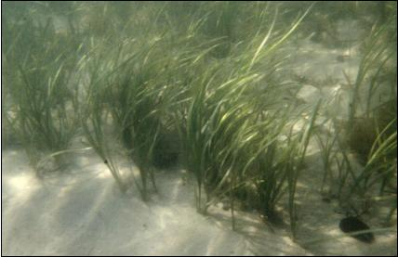
Why Eelgrass?
In brief…
Eelgrass acts as a nursery ground for shellfish & finfish
Eelgrass removes nitrogen waste from water
Eelgrass dampens wave energy helping to protect the beach
Global implications!
An eelgrass bed

Slide 12
Eelgrass Replacement Process
Make the mats
Harvest the shoots
Weave the mats
Transplant the shoots
Keep it going!

Slide 13
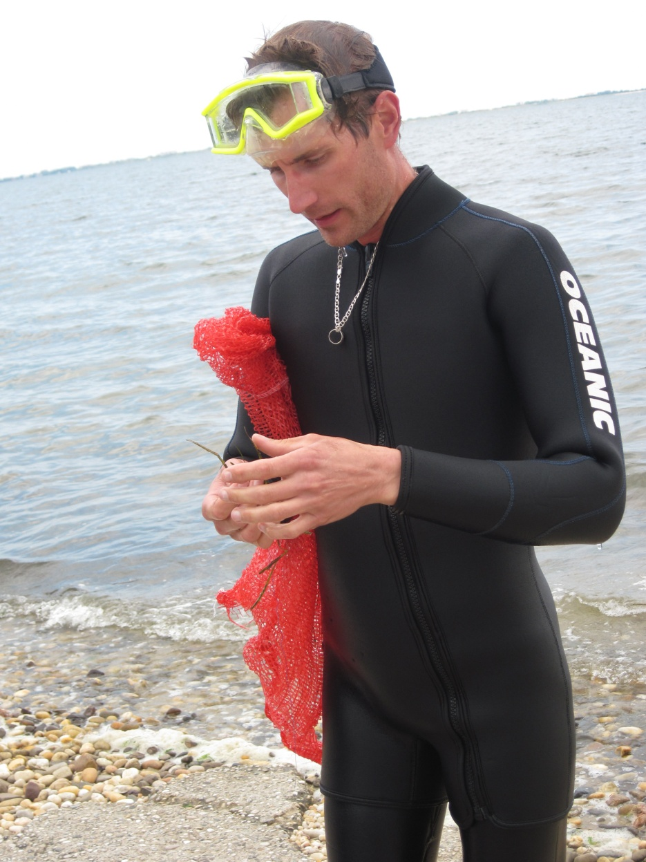
Harvest the Shoots
Greg checking the shoots before the harvesting begins.

Slide 14
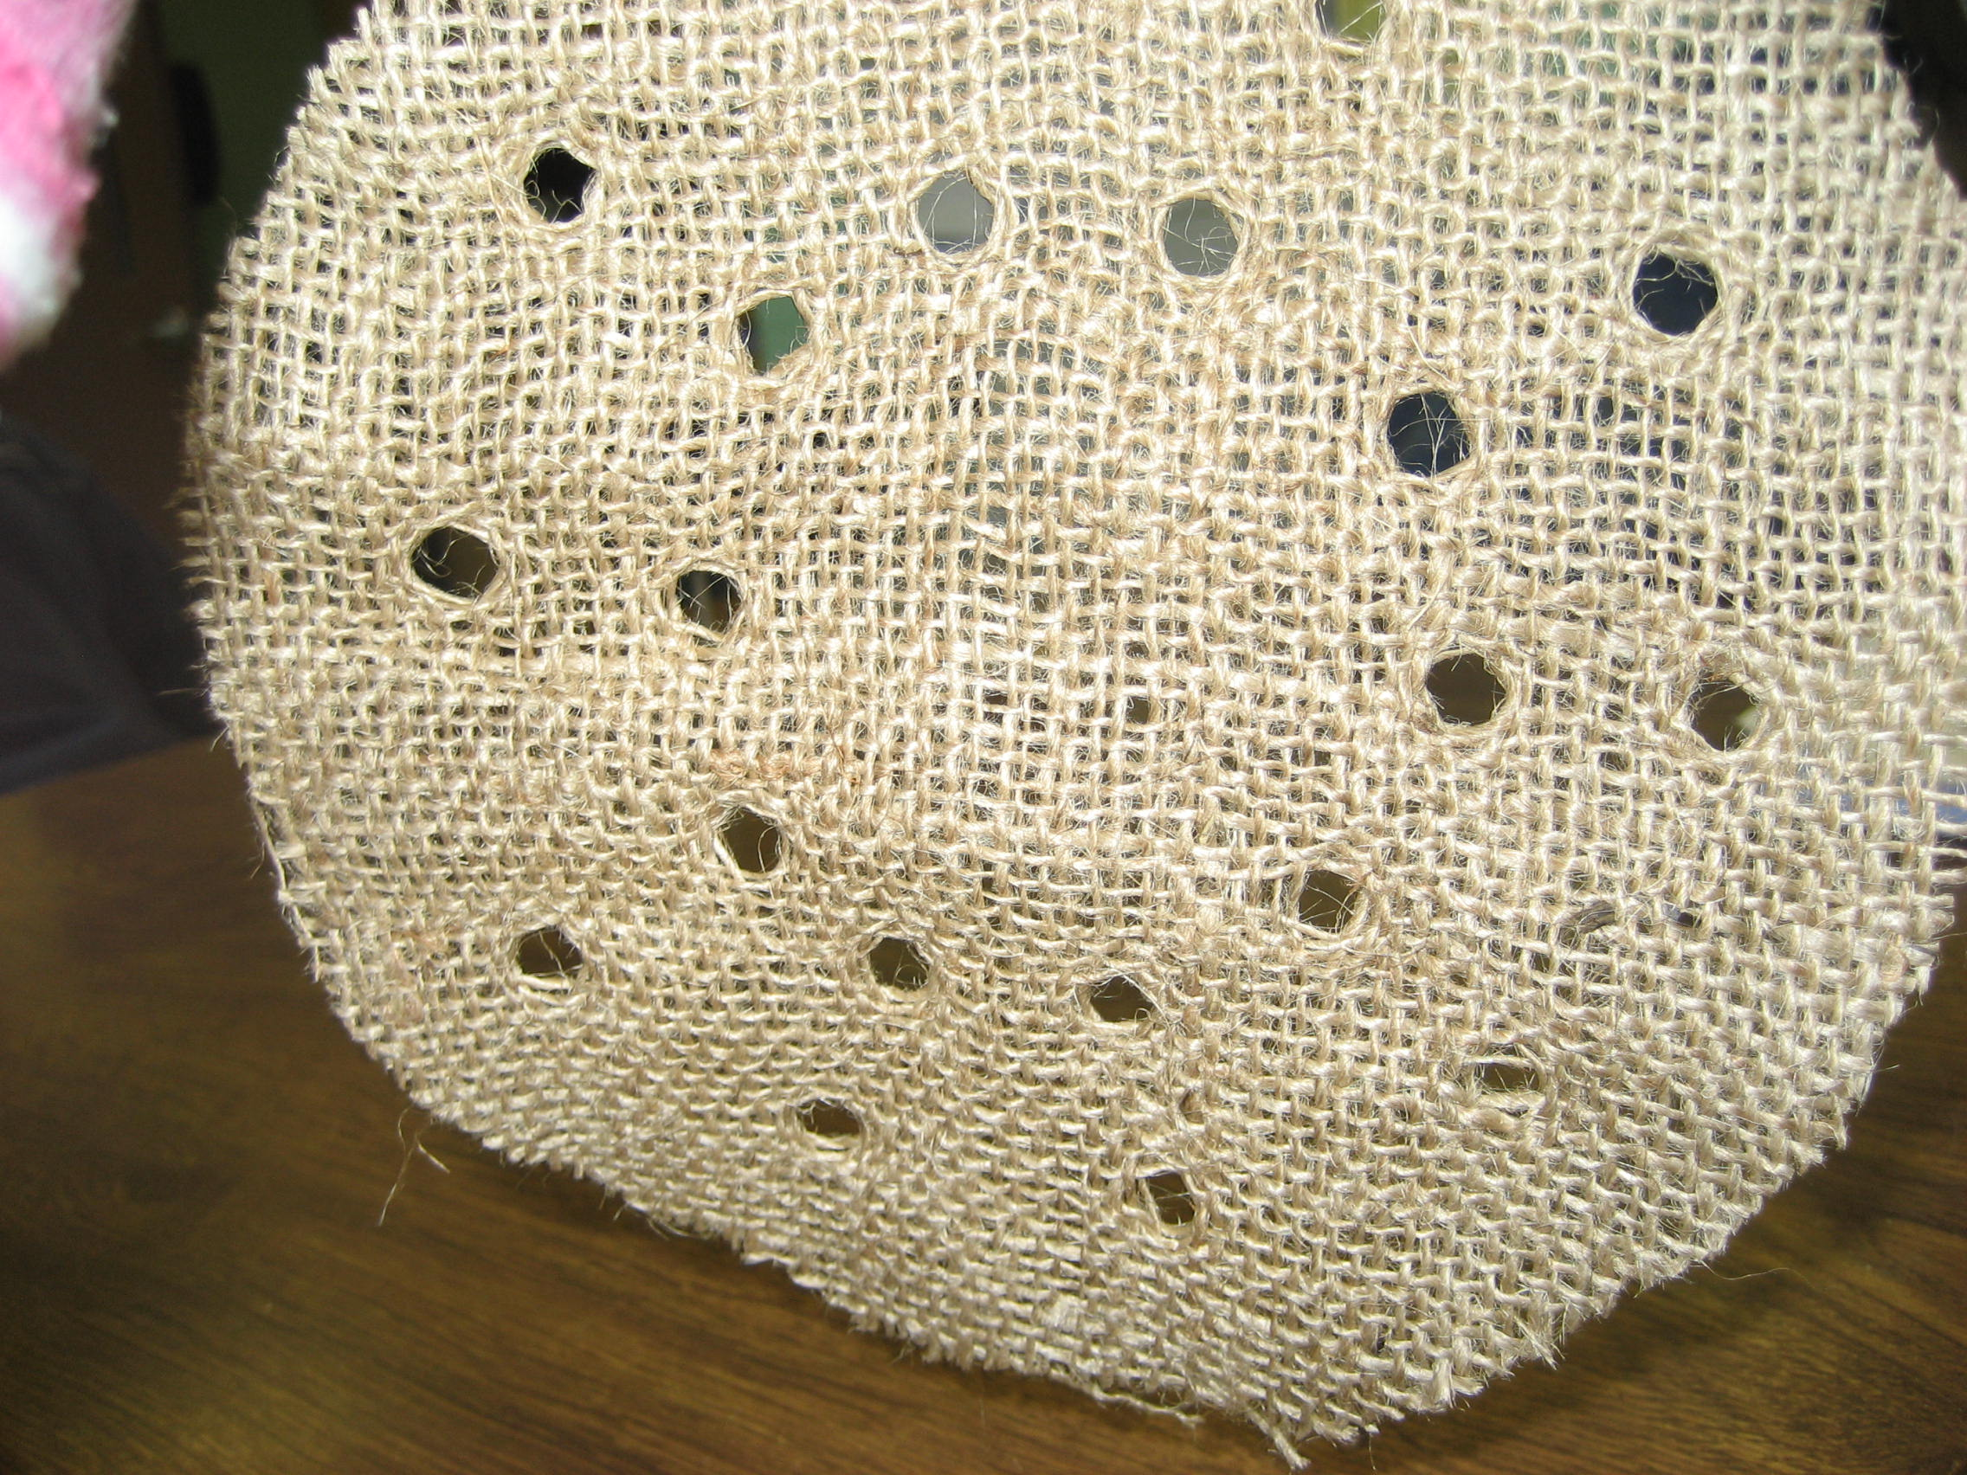
Make the Mats

Slide 15
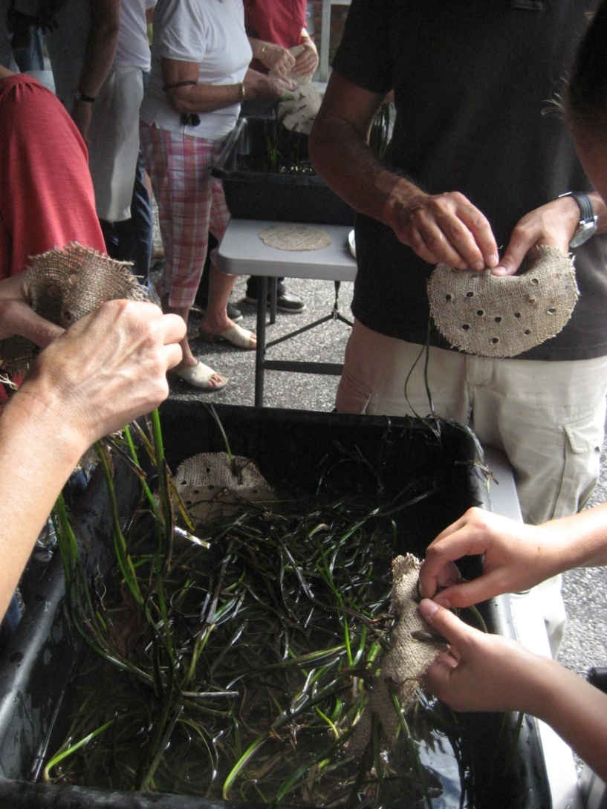
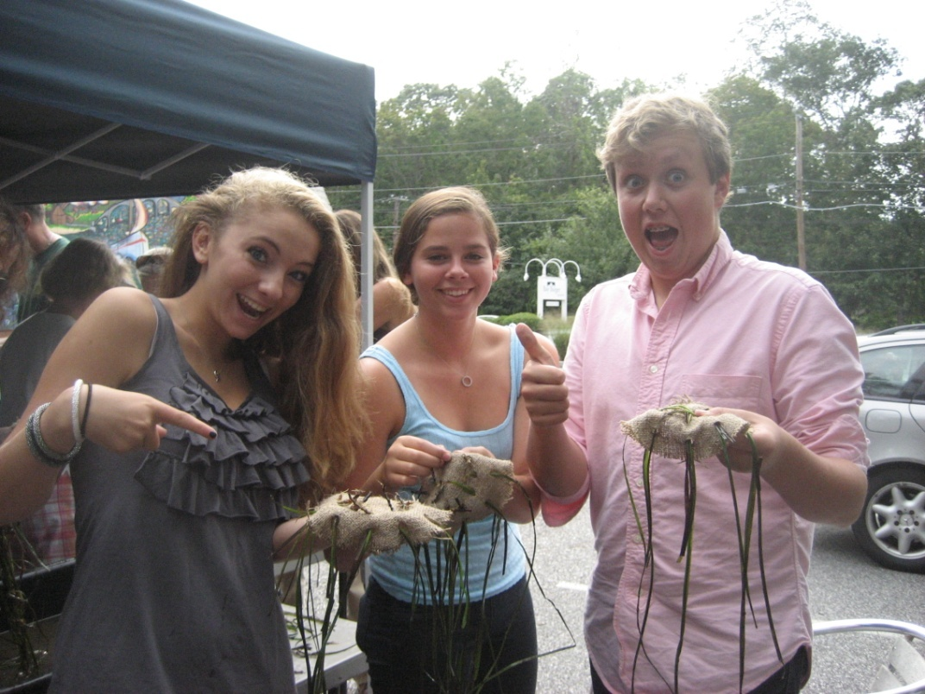
Weave the Mats

Slide 16
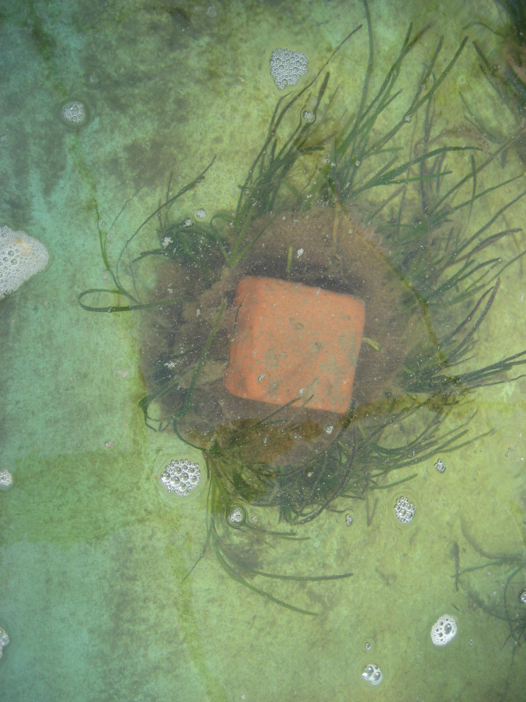
Transplant the Shoots
Mat woven with eelgrass shoots held under water in the lab with a brick.

Slide 17
Resources
Julia Best, Technology Education Teacher
jbest@southamptonschools.org
Greg Metzger, Marine Science Teacher
gmetzger@southamptonschools.org
Eric Pflug, Mathematics Teacher
epflug@southamptonschools.org
Seagrass Long Island -
www.seagrassli.org
Contact Kimberly Barbour, Habitat Restoration Outreach Specialist kp237@cornell.edu
Facebook – Marine Meadows Program page
www.facebook.com/pages/Marine-Meadows-Program/210110862383997

